Slide 1

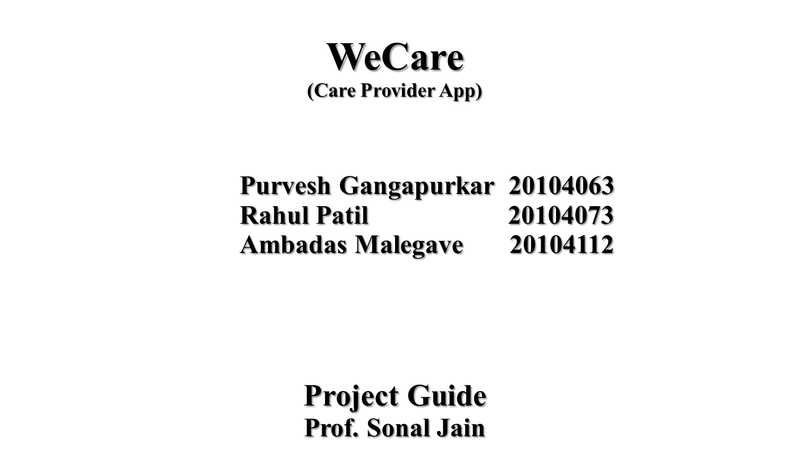

Slide 2
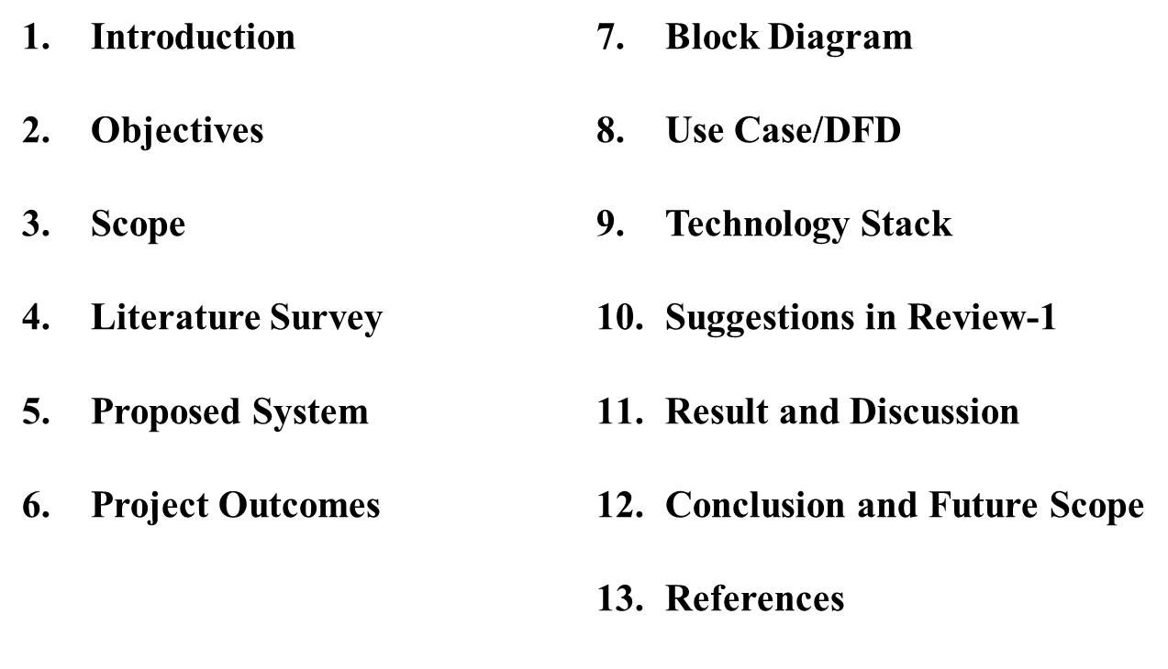
Contents

Slide 3
1. Introduction
Problem Identified :
We all are busy in our day to day lives and sometimes it is difficult to mange both work and home simultaneously.
Now-a-days its difficult to find a trust worthy person for our loved ones.
Solution Proposed :
Here we are introducing WeCare, Our app for sharing your responsibilities hand in hand.
We have trained, kind, humble and qualified companions who will help you by staying beside you.

Slide 4
2. Objectives
To serve people by sharing their responsibilities.
To ensure adequate qualitative care to people.
To provide quality service at an affordable price.
To provide employment in the care sector.

Slide 5
3. Scope
Bridging gap between who need care and who serves care.
Aiming to provide quality services at affordable prices.
Instant booking with desired services.
To provide employment for house workers.
To bring this service all over India.

Slide 6
4. Literature Survey
Family caregivers are a vital part of society. They are important to their loved one(s), for the healthcare system, and to the economy. They give up personal time and resources to care for someone else who is in need.
The Internet of Things is a new reality that is completely changing our everyday life, and promises to revolutionize modern healthcare by enabling a more personalized, preventive and collaborative form of care.
While a wide range of family caregiver apps are now available across the mHealth landscape, most apps offer limited functionality. Therefore, there is a need for multi-functionality app to avoid the inherent challenges that caregivers may experience.

Slide 7
5. Proposed System
User Friendly :
    Simple and interactive user interface.
    All services provided at one place.
Categories :
  Select Services according to your requirements.
3. Personalization:
    We provide customizable services.
Location based Search:
    Customer can find the nearest available service person in their locality to avail the service nearest to them.

Slide 8
6. Outcome of Project
Innovation to solve one of the greatest human challenges.
Users can search for options available.
Users can get personalized services.
Clients can book appointments from anywhere.
Our application is responsive.

Slide 9
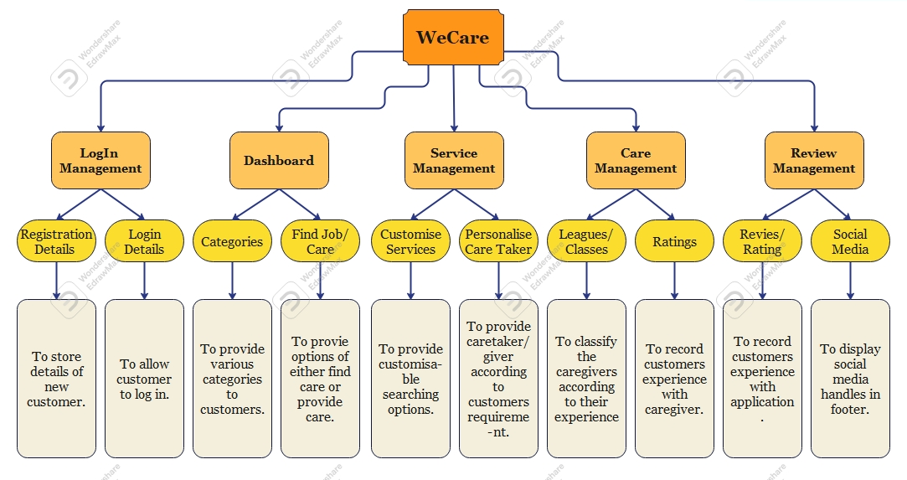
7. Block Diagram

Slide 10
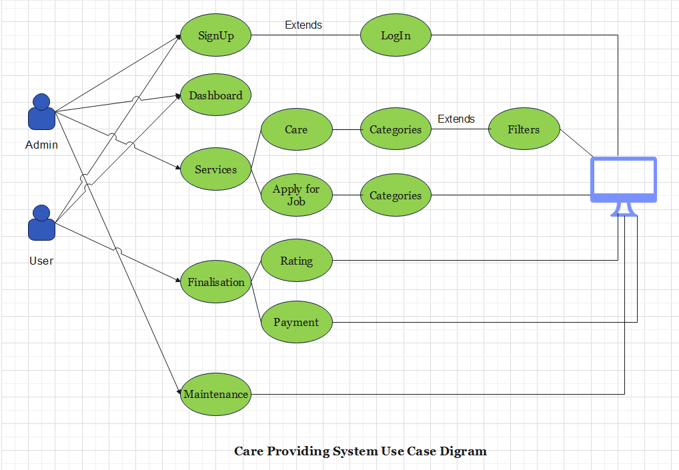
8. Use Case Diagram

Slide 11
9. Technology Stack
Front-end: HTML,CSS,JS
Database: Firebase
Integrated Development Environment (IDE):VS code
Platform: Windows 10/11

Slide 12
10. Suggestions In Review 1
Google Translate API.
Identity proof in applying for job form.
Proper formatting of caregiver’s information cards.
Conformation mail/sms to the user and caregivers.
Trial period feature in book caregiver section.

Slide 13
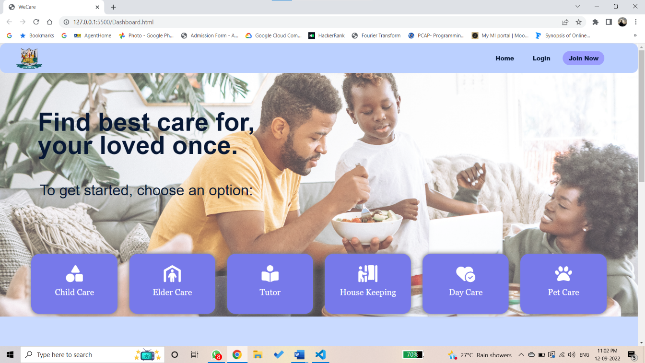
11. Result and Discussion
Dashboard: All the important information and functions are displayed on this page.

Slide 14
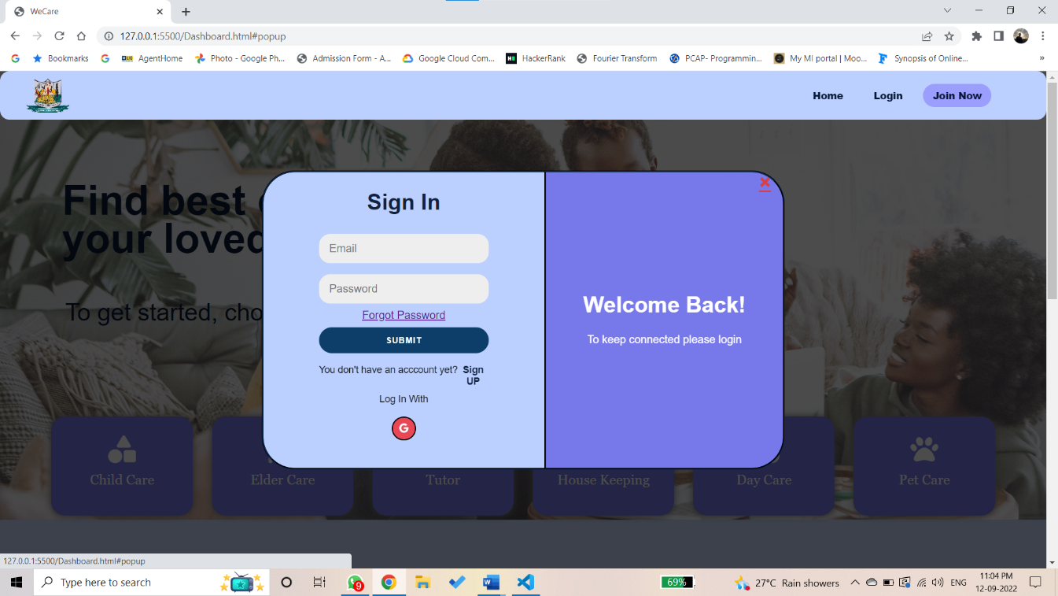
11. Result and Discussion
Login Page: The user can register and log in by using this page.

Slide 15
12. Conclusion and future scope
Conclusion:
Thus, care providing website will provide a user-friendly and easy interface to operate. Users can find caregivers of their choice. Users can select from various types of categories such as child care, elder care, etc. Users are able to translate the content of the website according to their preferences. Hence WeCare is a very helpful website for those who need care for their loved ones.

Slide 16
12. Conclusion and future scope(continued)
Future Scope:
We aim to make the website more user-friendly and attractive.
To reach a greater number of users and caregivers.
To provide user-specific customization based on their preferences.
We aim to provide more customization options according to the user’s needs.

Slide 17
13.References
1.The Change Foundation. Profile of family caregivers report. https://changefoundation.ca/wp-content/uploads/2016/06/Profile-of-Family-Caregivers-report-FINAL.pdf (2016, accessed 17 Nov 2021).
2. Ploeg J, Markle-Reid M, Valaitis R, et al. Web-based interventions to improve mental health, general caregiving outcomes, and general health for informal caregivers of adults with chronic conditions living in the community: rapid evidence review. J Med Internet Res 2017; 19: e263. [PMC free article] [PubMed] [Google Scholar]
3.Fox S, Brenner J. Family caregivers online. https://conalma.org/wp-content/uploads/2012/09/Family-Caregivers-Online.pdf. (2012, accessed 17 Nov 2021).
4.We-care: An IoT-based health care system for elderly people. https://ieeexplore.ieee.org/abstract/document/7915565 (Published in : 2017 IEEE International Conference on Industrial Technology (ICIT) ).

Slide 18
Thank You...!!

